Slide 1

Elkins High School
Course Selection
It’s a great day to be a knight!

Slide 2

Graduation Requirements
Foundation + Endorsements
4X4 Graduation Plan
26 Credits

Slide 3
What is a Credit?
A full year course will earn you 1 credit (1 credit awarded at the end of the year)
Ex. English 1, World Geography
A semester course will earn you a ½ credit (½ credit awarded at the end of the semester)
  Ex. Health, Communication Applications

Slide 4
What is an Endorsement?
Selecting an ENDORSEMENT is like choosing a MAJOR in College even if you plan to go directly into the workforce. It’s your career pathway into your field of interest.
There are 5 Endorsement Areas w/ each having several specializations:
    STEM (Science, Technology, Engineering and Math)
    Public Services (ex. Health Science, Education,/Training, Law Enforcement), (Culinary Arts, and Hospitality)
    Business and Industry (ex. Database Management, Info Technology, Communications, Accounting, Finance, Marketing, Graphic Design, Architecture, construction, Welding, HVAC, Logistics, Auto Tech, Agricultural Science)
    Arts and Humanities (ex. Literature, Languages, Fine Arts, History, Cultural Studies, Political Science)
    Multidisciplinary Studies (A variety of courses from the above 4 areas)

Slide 5

Required Core Courses:
English- 4 Credits
English I
English II
English III
English IV

Slide 6
Required Core Courses:
Math- 4 Credits
Algebra I
Geometry
Algebra II
4th Math Course
  *You MUST have credit for all of Algebra 1, Geometry and Algebra II before enrolling in your 4th math course!!!
  You CANNOT take Math Models once you have any Algebra II credit

Slide 7
Required Core Courses:
Science- 4 Credits
Biology
IPC or Chemistry
Physics
4th Science: Aquatic Science, Anatomy and Physiology, IPC, AP Biology/Chemistry/Physics, etc.
  If a student takes IPC, it is to be taken after Biology and CANNOT be taken once a student has any credit for Chemistry.

Slide 8
Required Core Courses:
Social Studies- 4 Credits
World Geography
World History
US History
Government (1/2 credit)
Economics (1/2 credit)

Slide 9

World Language
2 Credits
Both credits must be in the same language
Languages offered:
  Spanish
  French
  American Sign Language
Many colleges may REQUIRE 2 years of foreign language so it is advised that you earn foreign language credits

Slide 10
Fine Arts
1 Credit
Must be full credit of one of the following:
  Choir
  Band (audition only)
  Orchestra
  Dance
  Theatre Arts
  Art
  Music Theory (not available to Freshman)
  Music History (not available to Freshman)
  Art History (not available to Freshman)

Slide 11
Physical Education
1 Credit
Credit can be obtained from the following:
  Physical Education Team Sports (1/2 credit)
  Physical Education Individual Sports (1/2 credit)
  Foundations of Personal Fitness (1/2 credit)
Substitutions for PE
  Athletics
  Marching Band (1st semester only)
  JROTC
  Dance I
  Dance Team (not available to Freshman)
  Cheerleading (1st semester only)

Slide 12
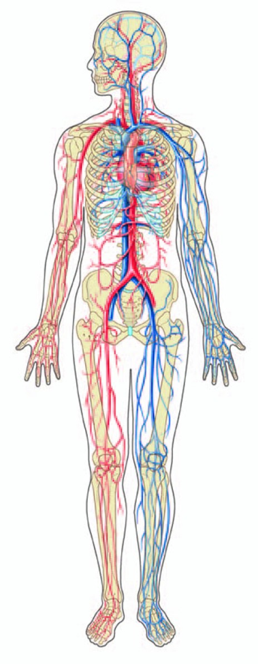
Health
½ Credit
Health Education Class-1/2 credit

Slide 13


Speech
½ Credit
Must be Professional Communication -
½ credit

Slide 14
Electives
5 Credits
Can choose any 5 credits of classes that lead toward a particular pathway or Endorsement
If a class is in addition to what is required, it is considered an elective.
  Ex. Additional Foreign Language, Math, or Science
  Study Hall, Office Aide (seniors only) and Off-Campus (seniors only) do not count since they are non-credit- bearing classes

Slide 15
Endorsement Electives
Principles of Agriculture, Food, & Natural Resources*
Principles of Architecture & Construction*
Principles of Arts, AV Technology, & Communications*
Principles of Business , Marketing, & Finance (ALL)
Principles of Education & Training*
Principles of Health Science*
Principles of Hospitality & Tourism*
Human Services I(only offered in middle school)
Principles of Human Services*++
  (Human Services I is a PreReq)
Production & Info Technology(only offered in middle school)
Principles of Information Technology*++
  (Production & Info Technology is a Pre-Req)
Principles of Law, Public Safety, Corrections, & Security*
Principles of Manufacturing*
Concepts of Engineering & Technology*
Gateway to Technology 1,2,3* (GTT 1 & 2 only offered in middle school)
  Project Lead the Way
*=not currently available at all high schools
E=Endorsement
++=available for middle and high schools

Slide 16

Remember, you need…
4 Credits of English
4 Credits of Math
4 Credits of Science
4 Credits of Social Studies
2 Credits of World Language
½ Credit of Health
½ Credit of Communication Applications
1 Credit of PE
1 Credit of Fine Arts
5 Credits of Electives
***TOTAL: 26

Slide 17

Why is 9th grade important for my future?
Grades determine your GPA and Class Rank used for post-secondary opportunities!!
***Every year counts!

Slide 18
Create a 4 Year Plan
Use Your Course Guide to help you plan for the courses you need and would like to take at EHS
Go to FBISD website-> Parent/Student Information-> Program Guides-> High School Program Guide 2014-2015

Slide 19
GET INVOLVED-Do not wait until your senior year to join activities!
*Volunteer
YES Service Organization at school
*Join a club/team at school
*Part time jobs

Slide 20
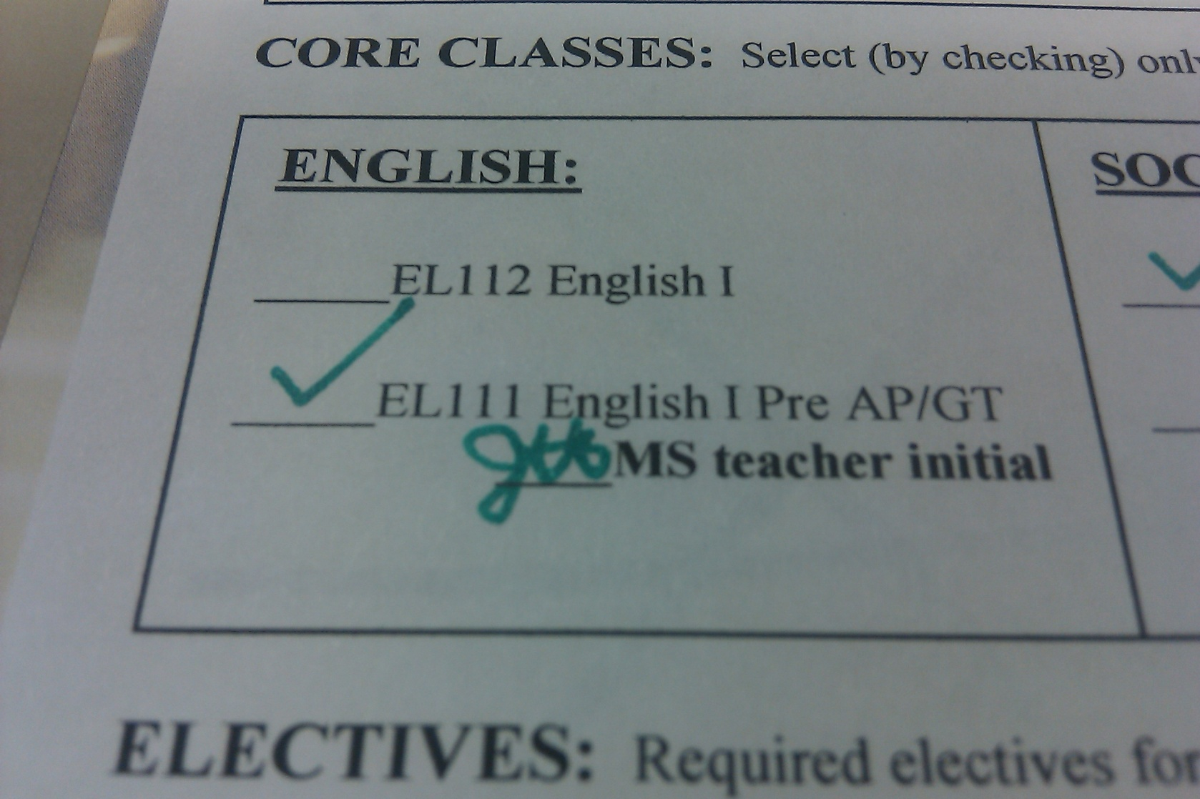
English

Slide 21
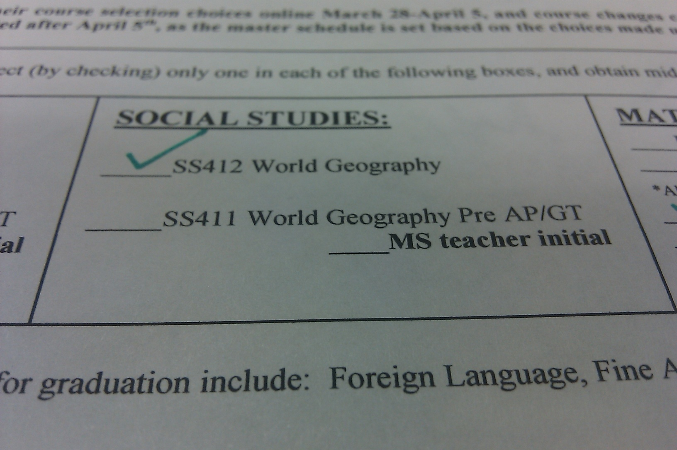
Social Studies

Slide 22
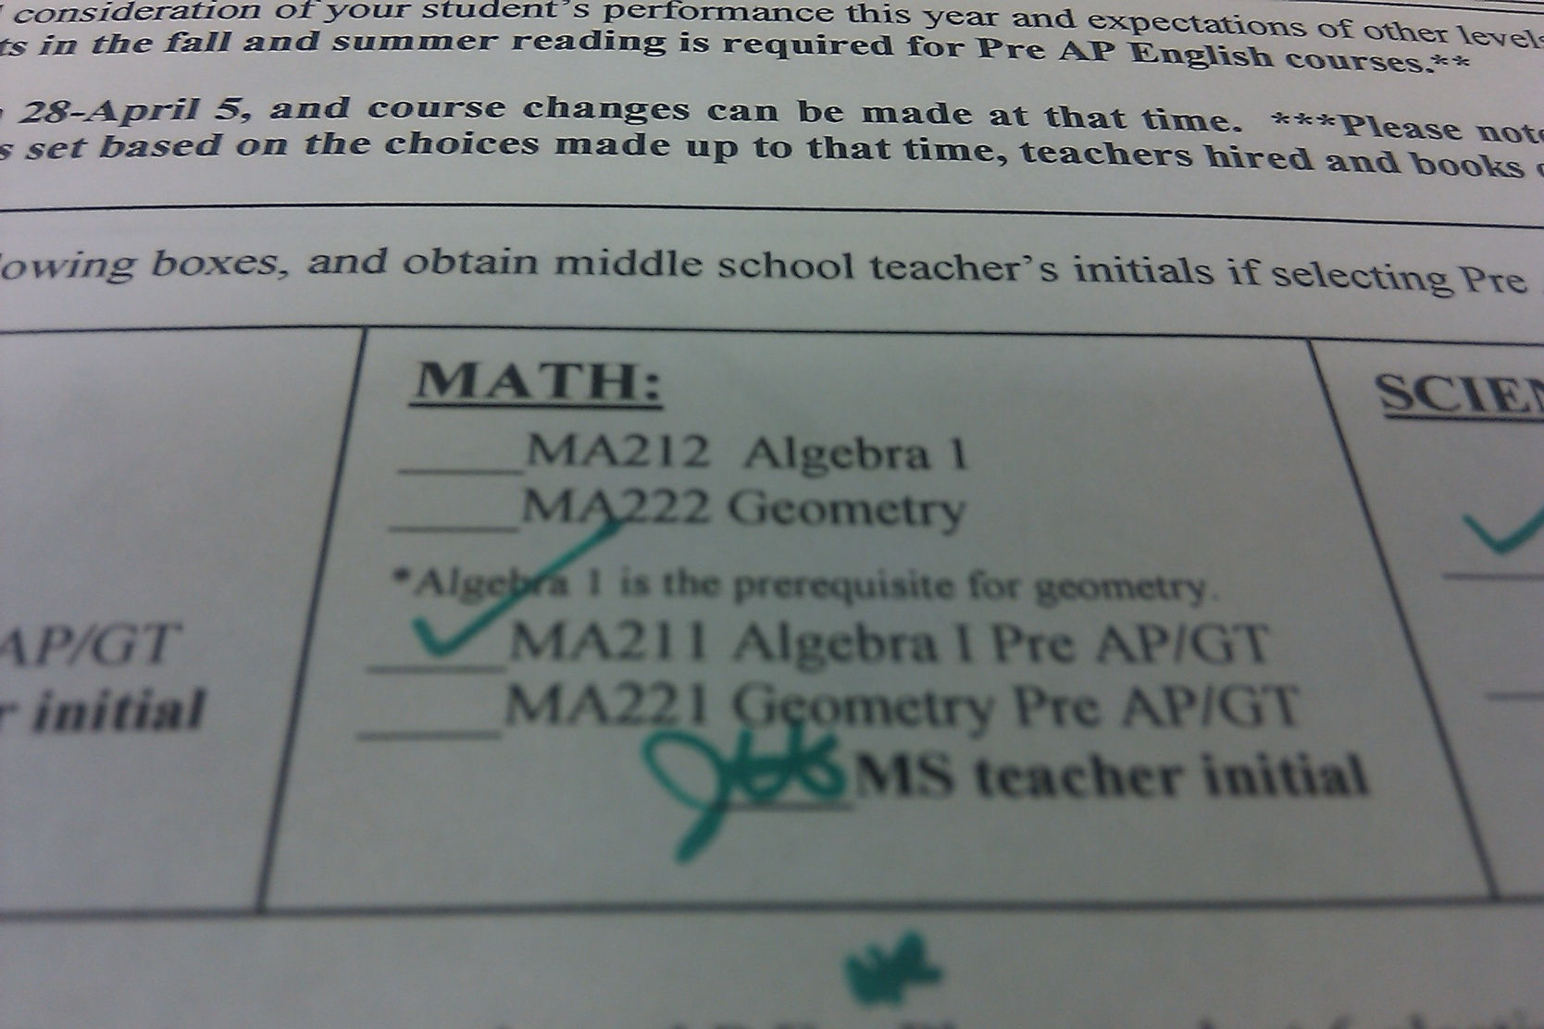
Math

Slide 23
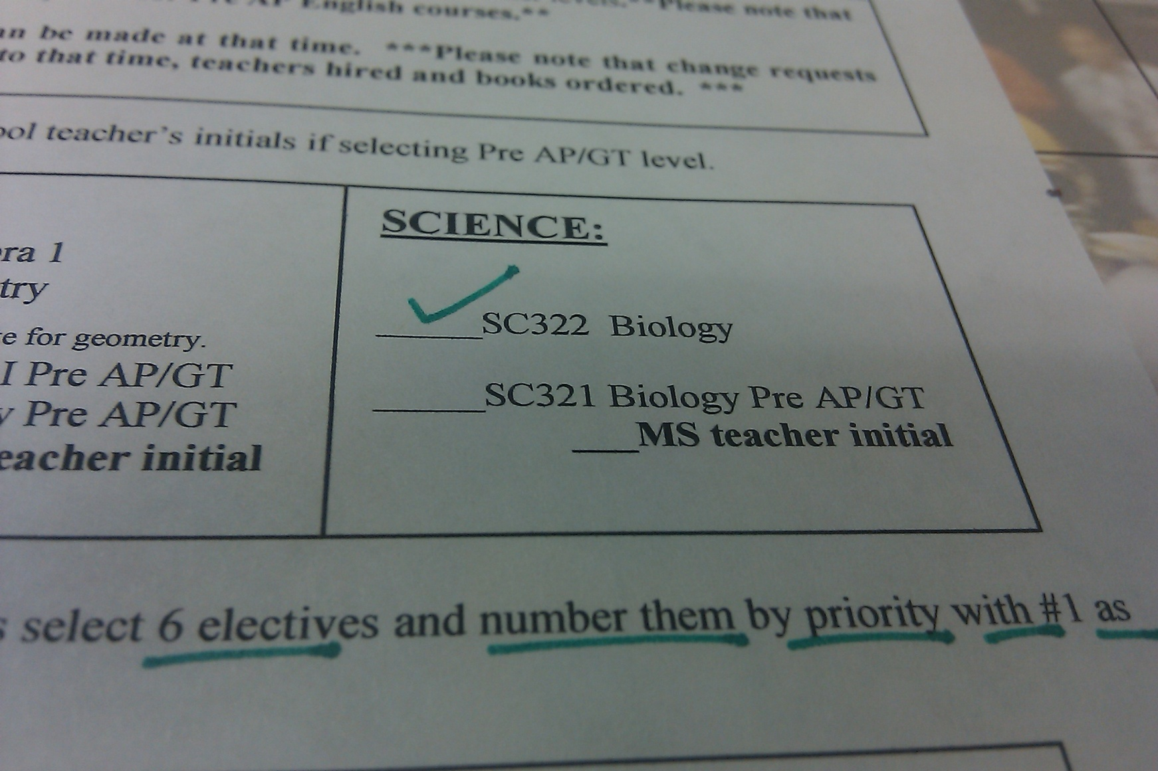
Science

Slide 24
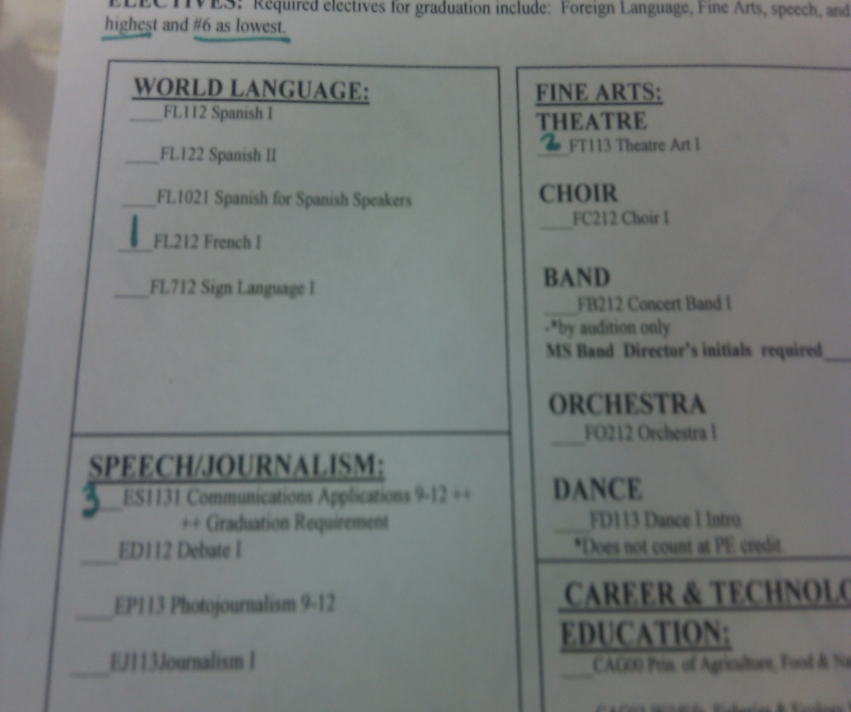
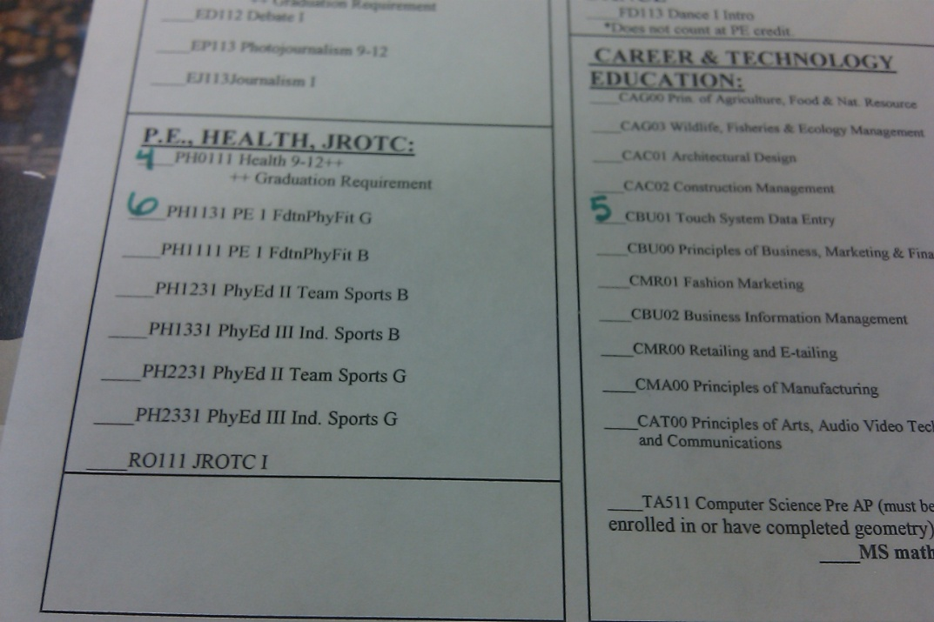
Electives- Choose 6 and Rank Them (#1 highest-#6 lowest)!

Slide 25
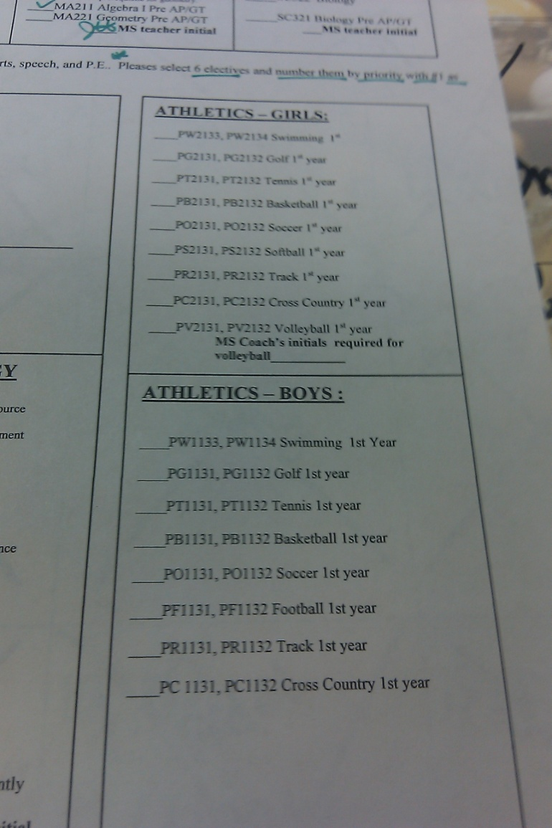
Electives- Choose 6 and Rank Them (#1 highest-#6 lowest)!

Slide 26
REMINDER
Return Yellow Course Selection Worksheets
  Lake Olympia
  Quail Valley
  Fort Settlement
  First Colony
At that time, students will be given a White Course Selection Form and transfer their selections onto that form.

Slide 27
Online Course Selection
Online input window: Feb. 10th- Feb.28th
Your student’s current counselor at the middle school campus will train and assist students with inputting course selections online.

Slide 28


The Road to College:
Rigor, Readiness, and Retention
Notes:
28

Slide 29
The Mission of AVID
AVID's mission is to close the achievement gap by preparing all students for college readiness and success in a global society.
Notes:
29

Slide 30
What is AVID?
  A structured, college preparatory system working directly with schools and districts
  A direct support structure for first-generation college goers, grades 4-16
  A schoolwide approach to curriculum and rigor adopted by more than 4,500 schools in 47 states and 16 countries
  A professional development program providing training throughout the world
Notes:
30

Slide 31
The AVID Elective Student Profile
Students With Academic Potential
  Average to high test scores
  2.0-3.5 GPA
  College potential with support
  Desire and determination
Meets One or More of the Following Criteria
  First to attend college
  Historically underserved in four-year colleges
  Low income
  Special circumstances
Notes:
31

Slide 32
What is Academic Rigor?
Rigor is the goal of helping students develop the capacity to understand content that is complex, ambiguous, provocative, and personally or emotionally challenging.
Taking rigorous courses opens doors!
Source: Teaching What Matters Most; Standards and Strategies for Raising Student Achievement by Strong, Silver and Perini, ASCD, 2001.
Notes:
32

Slide 33
Expectations
Participate in a minimum of one extracurricular activity per semester
Participate in 8 hours per semester of community service
Complete a minimum of 2 Honors/Pre-AP or College Now courses each year
Contribute to the philosophy of the AVID Program
Notes:
33

Slide 34
A Week in the AVID Elective
2 days/week-AVID Curriculum
2 days/week-Study Groups
1 day/week-Critical-thinking activities, Guest speakers
Notes:
34

Slide 35
CONTACT INFORMATION
Brian.Tucker@fortbendisd.com
W: (281)634-4290
Brian.Williams@fortbendisd.com
Work: (281)634-2615

Slide 36
REMINDER
Middle school counselors will field any questions 8th graders have about online input. High school counselors will not have access to 8th grade student selections until later in the year.
If students want to make a change after inputting their courses online, they must print their schedule, make the correction, obtain a parent signature and return it to their middle school counselor no later than March 22nd .

Slide 37
Reminder!!!
New Knight Orientation will be during August- more information will be posted on the EHS website when available.
We look forward to having you at Elkins High School next year!
Welcome to the Castle!

